Slide 1
Online Payments Fraud Detection with Machine Learning
Guide: Prof. Srinivasa Reddy Konda

Slide 2
TEAM MEMBERS
K.SAI DEEPAK 20BCD7092
G.HARISH 20BCD7101
U.MANISH 20BCE7589

Slide 3
AGENDA
Abstarct
Literature review
​Methodology
Results
​conclusion​

Slide 4
Abstract
Online payment fraud has become a significant challenge for businesses and financial institutions, as fraudulent activities have been increasing rapidly in recent years. Fraudsters use various techniques such as stolen credit card information, account takeover, and phishing to commit fraud, which can cause significant financial losses and damage to the reputation of businesses. Traditional fraud detection methods, such as rule-based systems, are becoming less effective in detecting sophisticated fraudulent activities.
It can analyze large amounts of data and identify patterns that are indicative of fraudulent activities
Machine learning has emerged as a powerful tool for fraud detection in online payments.
In this research paper, we present a comprehensive overview of machine learning techniques used in online payment fraud detection.

Slide 5
Machine learning models can be trained on various types of data, such as transaction data, user behavior data, and device information. These models can then be used to predict the likelihood of a transaction being fraudulent based on the input data.
Analysis of various machine learning algorithms and techniques that are commonly used in online payment fraud detection. These techniques include logistic regression, decision trees, random forests, support vector machines, knn,and xgboost.
The traditional fraud detection methods use rule-based systems that identify suspicious patterns in the transaction data. However, these methods have limitations in detecting sophisticated fraud techniques that can bypass the rule-based systems. Machine learning can overcome these limitations by learning from the historical transaction data and identifying the patterns that are indicative of fraudulent activities.
We present a case study that demonstrates the effectiveness of machine learning in detecting online payment fraud. We use a real-world dataset to train and evaluate several machine learning models. We compare the performance of different models based on accuracy, and F1 score.

Slide 6
Literature review
"Detecting Payment Card Fraud Using Machine Learning Techniques" by Ashraf Aljammal, Ali Alkhalifah, and Marwah Almasri.
"Fraud Detection Using Machine Learning: A Systematic Literature Review" by Mohamad Eldeeb, Ahmed Salaheldin, and Ahmed Youssef.
"Anomaly Detection for Online Payment Fraud Detection: A Machine Learning Approach" by R. Jyothsna and N. Jayanthi.
"Detecting Online Payment Fraud Using Machine Learning Techniques" by S. S. Sivanandam and S. Sumathi.
"A Machine Learning Approach to Online Payment Fraud Detection" by Anjali V. Kulkarni and Prachi M. Joshi.
"A Comparative Study of Machine Learning Techniques for Credit Card Fraud Detection" by Umang Patel and Bhavesh Borisaniya.
"A Novel Approach to Detect Payment Fraud Using Gradient Boosting Machine" by Arpit Shah, S. Balaji, and G. Geetha.

Slide 7
Methodology
Data Collection and Preprocessing
Model Selection
Model Training and Validation
Results
conclusion

Slide 8
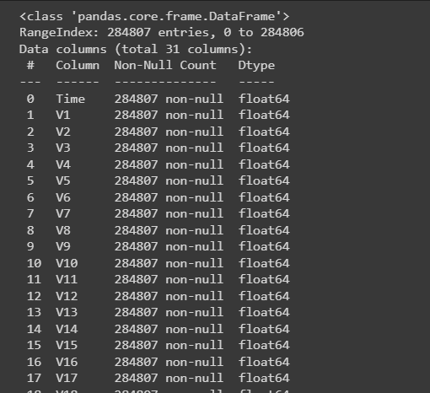

implementation
Data set importing

Slide 9
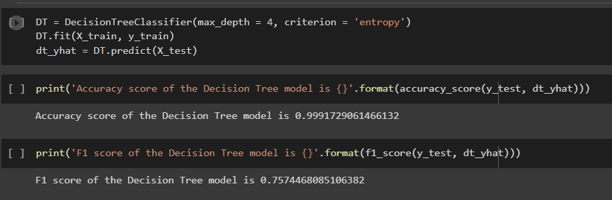
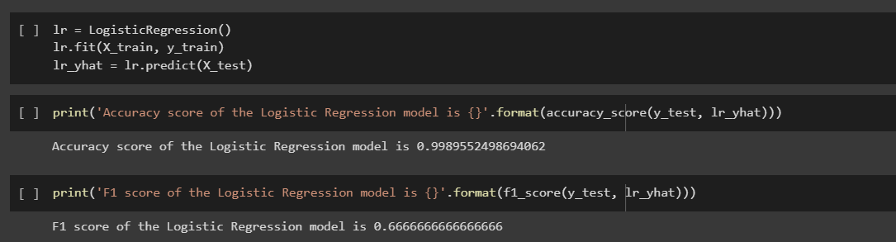
Results (Accuracy and f1 score )

Slide 10
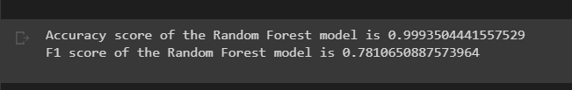
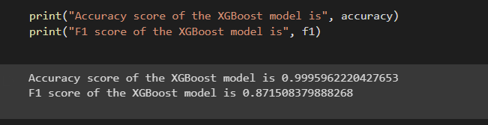

Slide 11
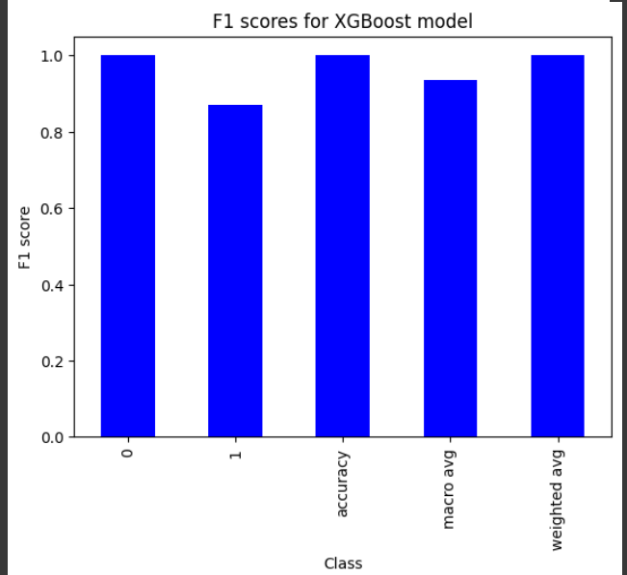
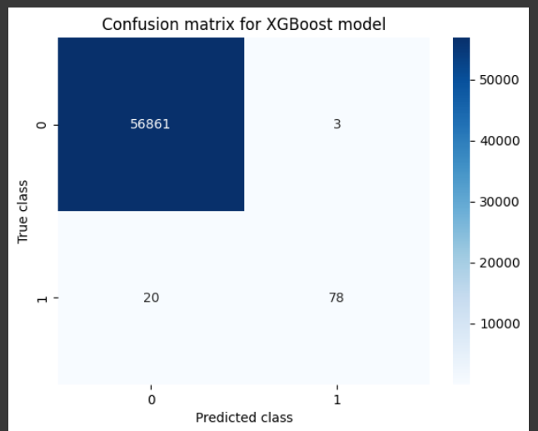
Plots

Slide 12
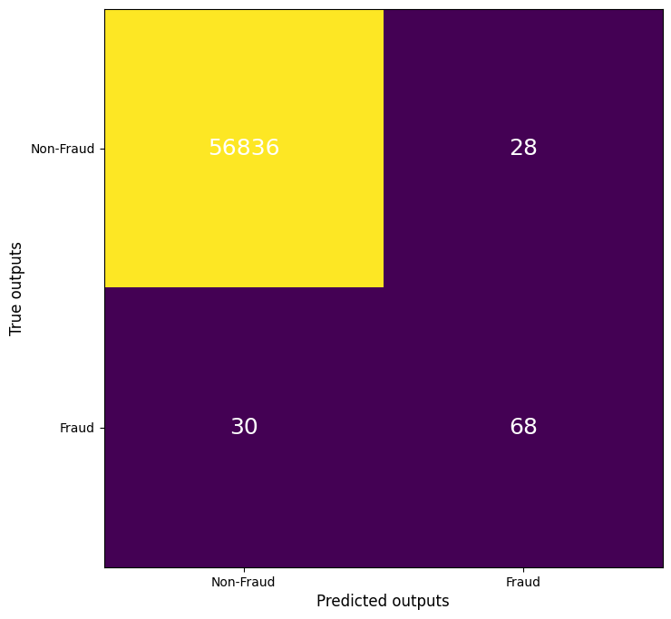
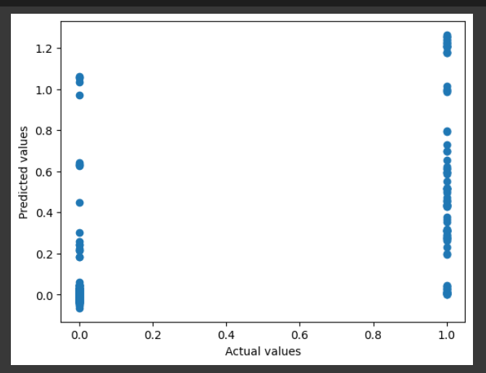
plots
Logistic regression

Slide 13
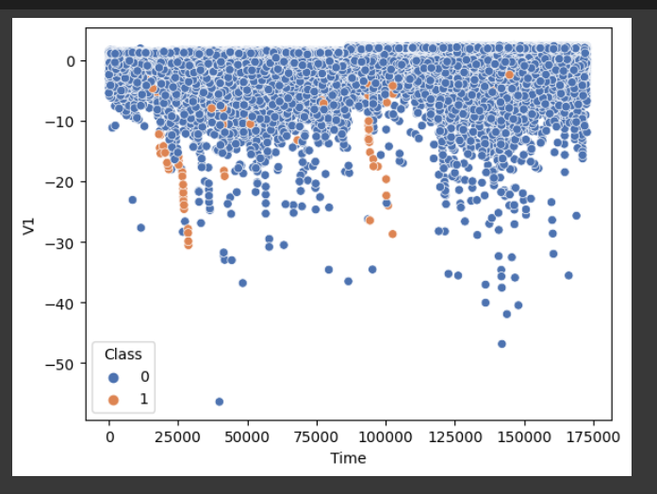
…
Knn scatter plot

Slide 14
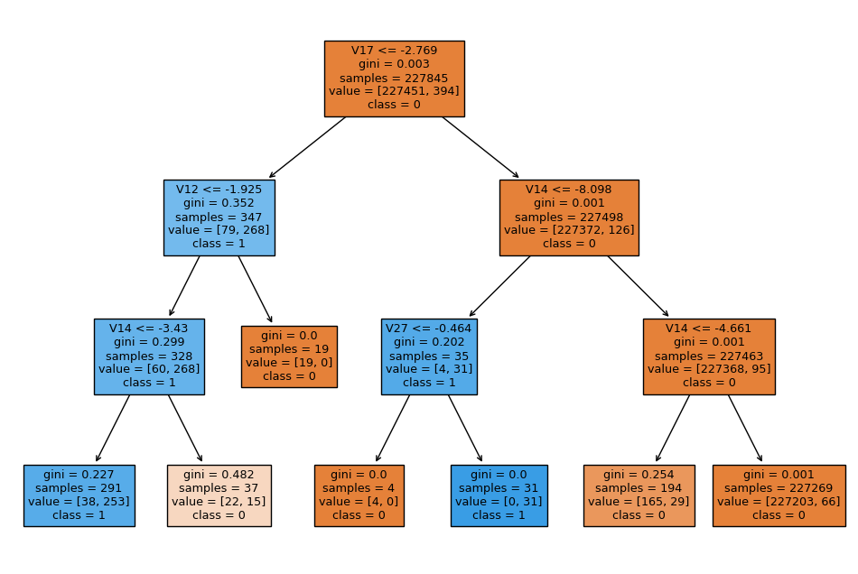
Decision tree

Slide 15
conclusion
In conclusion, this project demonstrated the effectiveness of using machine learning techniques for fraud detection in financial transactions. We explored various machine learning models such as logistic regression, decision trees, random forests, k-nearest neighbors, support vector machines, and XGBoost and evaluated their performance using accuracy and F1 score metrics.
After evaluating the models, we found that the random forest and XGBoost models performed the best, with F1 scores of 0.77 and 0.87, respectively. We also used visualization techniques such as confusion matrices and ROC curves to gain insights into the strengths and weaknesses of each model.
Overall, this project showcased the power of machine learning in fraud detection and offered a practical example of building a fraud detection system using Python. With the increasing prevalence of fraud in various industries, this project highlights the importance of leveraging machine learning in mitigating this risk.

Slide 16
THANK YOU
K.SAI DEEPAK 20BCD7092
G.HARISH 20BCD7101
U.MANISH 20BCE7589

